Slide 1
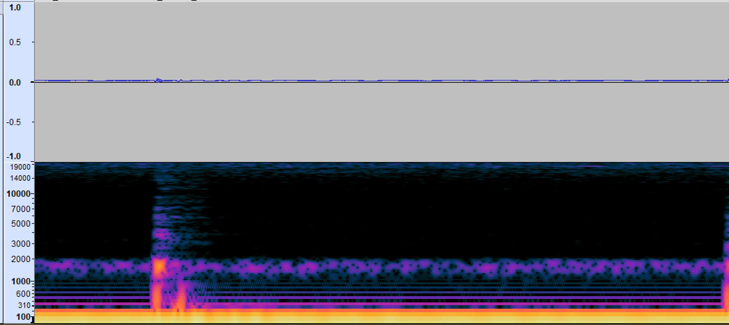

Signal Processing
Audacity
Raw Signal
Processed Signal

Slide 2


Energy Zero Crossing Voice Activation Detection Segmentation

Slide 3



Slide 4
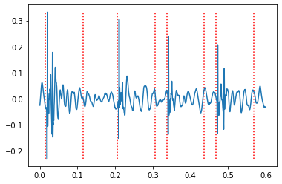
VAD Segmentation

Slide 5
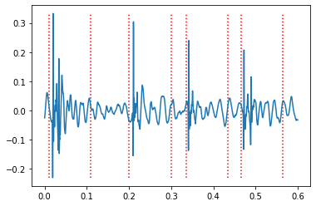
NLEO Segmentation

Slide 6
What’s next

